Slide 1
Barrel shifter
Presented by Apoorva And Anu

Slide 2
INTRODUCTION
A barrel shifter is a digital circuit that can shift a data word by a specified number of bits without use of any sequential logic, only pure combinational logic[1].
There are 3 type of bitwise shift operation: logical shift, arithmetic shift, and circular shift (rotate).
We can shift the data to the left as well as to the right.
The barrel shifter in this tutorial is a multifunction barrel shifter that can perform left or right circular shift.

Slide 3
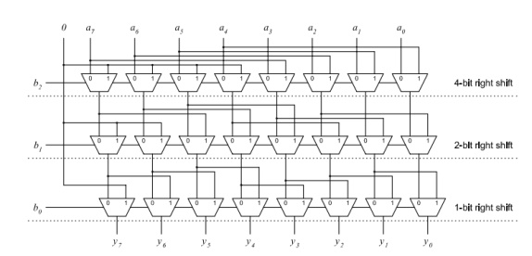
BLOCK DIAGRAM

Slide 4
VERILOG CODE
///8 bit Barrel Shifter Verilog Code
module barrel_shifter_8bit (in, ctrl, out);
input [7:0] in;
input [2:0] ctrl;
output [7:0] out;
wire [7:0] x,y;
//4bit shift right
mux2X1 ins_17 (.in0(in[7]),.in1(1'b0),.sel(ctrl[2]),.out(x[7]));
mux2X1 ins_16 (.in0(in[6]),.in1(1'b0),.sel(ctrl[2]),.out(x[6]));
mux2X1 ins_15 (.in0(in[5]),.in1(1'b0),.sel(ctrl[2]),.out(x[5]));
mux2X1 ins_14 (.in0(in[4]),.in1(1'b0),.sel(ctrl[2]),.out(x[4]));
mux2X1 ins_13 (.in0(in[3]),.in1(in[7]),.sel(ctrl[2]),.out(x[3]));
mux2X1 ins_12 (.in0(in[2]),.in1(in[6]),.sel(ctrl[2]),.out(x[2]));
mux2X1 ins_11 (.in0(in[1]),.in1(in[5]),.sel(ctrl[2]),.out(x[1]));
mux2X1 ins_10 (.in0(in[0]),.in1(in[4]),.sel(ctrl[2]),.out(x[0]));

Slide 5
//2bit shift right
mux2X1 ins_27(.in0(x[7]),.in1(1'b0),.sel(ctrl[1]),.out(y[7]));
mux2X1 ins_26 (.in0(x[6]),.in1(1'b0),.sel(ctrl[1]),.out(y[6]));
mux2X1 ins_25 (.in0(x[5]),.in1(x[7]),.sel(ctrl[1]),.out(y[5]));
mux2X1 ins_24 (.in0(x[4]),.in1(x[6]),.sel(ctrl[1]),.out(y[4]));
mux2X1 ins_23 (.in0(x[3]),.in1(x[5]),.sel(ctrl[1]),.out(y[3]));
mux2X1 ins_22 (.in0(x[2]),.in1(x[4]),.sel(ctrl[1]),.out(y[2]));
mux2X1 ins_21 (.in0(x[1]),.in1(x[3]),.sel(ctrl[1]),.out(y[1]));
mux2X1 ins_20 (.in0(x[0]),.in1(x[2]),.sel(ctrl[1]),.out(y[0]));

Slide 6
//1 bit shift right
mux2X1 ins_07 (.in0(y[7]),.in1(1'b0),.sel(ctrl[0]),.out(out[7]));
mux2X1 ins_06 (.in0(y[6]),.in1(y[7]),.sel(ctrl[0]),.out(out[6]));
mux2X1 ins_05 (.in0(y[5]),.in1(y[6]),.sel(ctrl[0]),.out(out[5]));
mux2X1 ins_04 (.in0(y[4]),.in1(y[5]),.sel(ctrl[0]),.out(out[4]));
mux2X1 ins_03 (.in0(y[3]),.in1(y[4]),.sel(ctrl[0]),.out(out[3]));
mux2X1 ins_02 (.in0(y[2]),.in1(y[3]),.sel(ctrl[0]),.out(out[2]));
mux2X1 ins_01 (.in0(y[1]),.in1(y[2]),.sel(ctrl[0]),.out(out[1]));
mux2X1 ins_00 (.in0(y[0]),.in1(y[1]),.sel(ctrl[0]),.out(out[0]));
endmodule

Slide 7
/2X1 Mux
module mux2X1( in0,in1,sel,out);
input in0,in1;
input sel;
output out;
assign out=(sel)?in1:in0;
endmodule

Slide 8
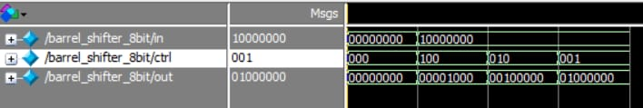
OUTPUT

Slide 9
THANK YOU

